Slide 1
MongoDB operations
Deepak Srinivasan

Slide 2
Index
1. Data Base
1.1. Databases view 1.2. Database Use
2. Collection
2.1. Create Collection 2.2. Drop Collection
3. Insert
3.1. Insert One 3.2. Insert Many
4. Update
4.1. Update One
4.2. Update using $inc
4.3. Update using $mul

Slide 3
Index
5. Delete
5.1. Delete One 5.2. Delete Many
6. Find
6.1. Find One 6.2. Find all name & age 6.3. Find using $and, $gt
7. Stats
7.1 Stats() before inserting Document. 7.2. Stats() after inserting Document
8. One to One Relationship (Patient & Disease)

Slide 4
Index
9. One to Many Relationship (Patient & Disease)
10. One to Many Relationship (Paper & Answer)
11. Many to Many Relationship (Authors & Books)
12. Many to One Relationship (Authors & Books)
13. Aggregate
14. Validation
15. Write Concern
17. Next() → shows first 20 documents
18. ForEach → shows all documents

Slide 5
Databases view Database Use
To view all the database
Eg: > show databases
To use particular database or to create new database
Eg: > use “database name”
To drop database
Eg: > db.dropDatabase();

Slide 6
Create Collection Drop Collection
To create collection in database
db.createCollection(‘”Collection name”’);
To delete collection in database
db. ”Collection name”.drop();
To display collection
show collections

Slide 7

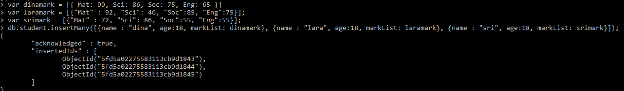
Insert One Insert Many

Slide 8
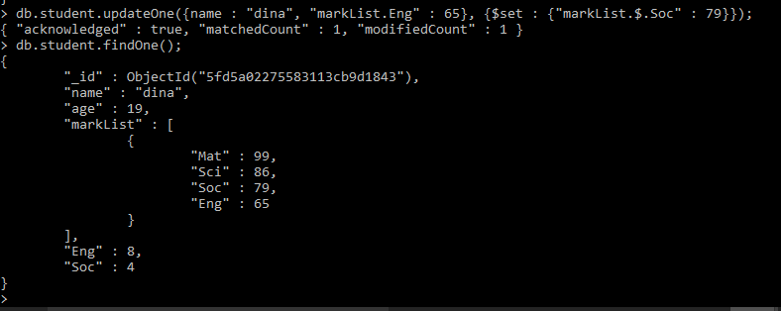
Update One

Slide 9
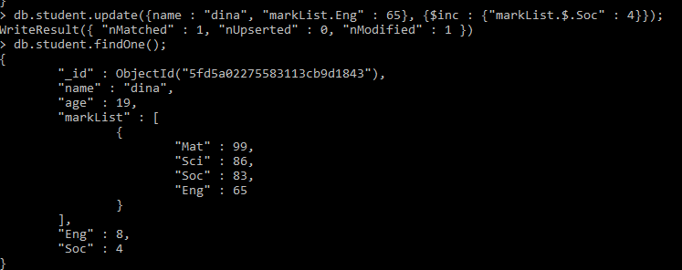
Update using $inc

Slide 10
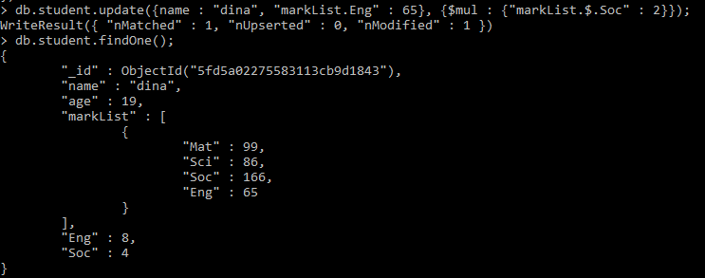
Update using $mul

Slide 11
Delete One Delete Many
To delete one document
db.”collection name”.remove({“name": “dina"});
WriteResult({ "nRemoved" : 1 })
To delete All document
db.”collection name”.remove({});

Slide 12
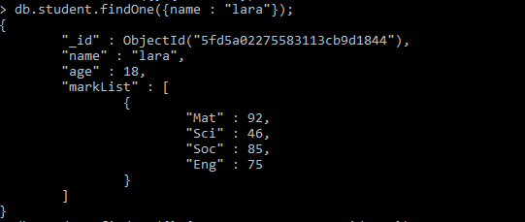
Find One

Slide 13

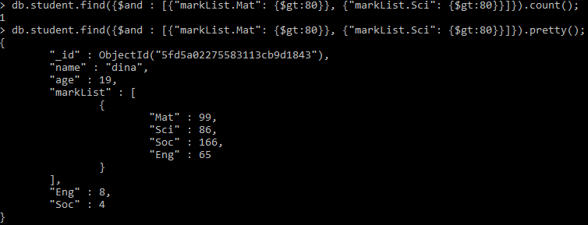
Find all name & age Find using $and, $gt

Slide 14
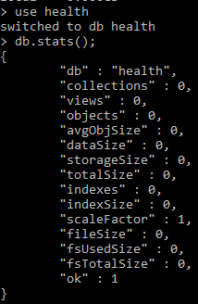
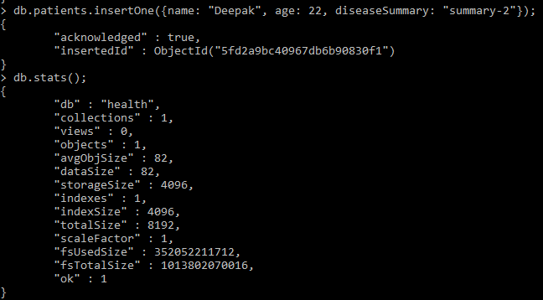
Stats() before inserting Document. Stats() after inserting Document

Slide 15
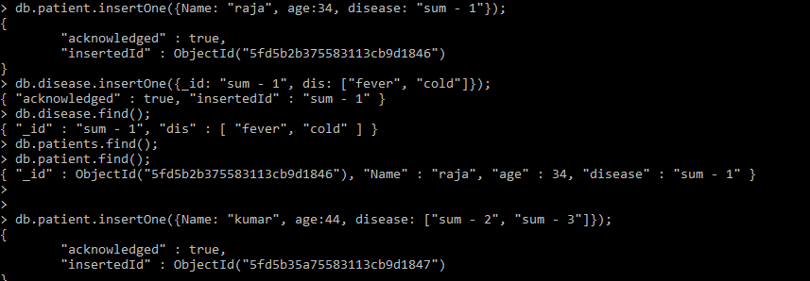
One to One Relationship (Patient & Disease)

Slide 16
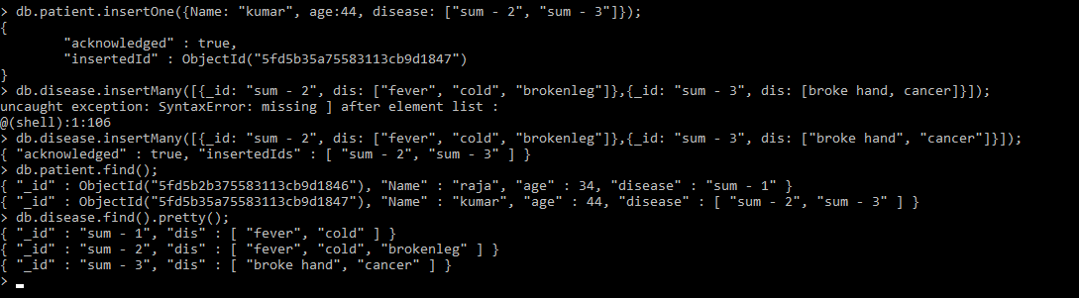
One to Many Relationship (Patient & Disease)

Slide 17
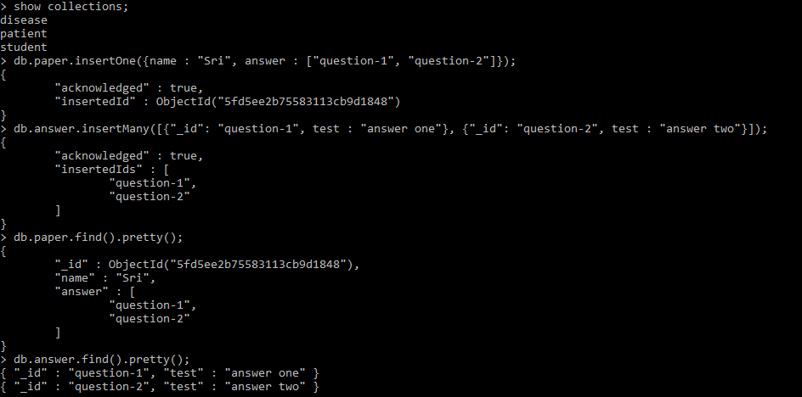
One to Many Relationship (Paper & Answer)

Slide 18
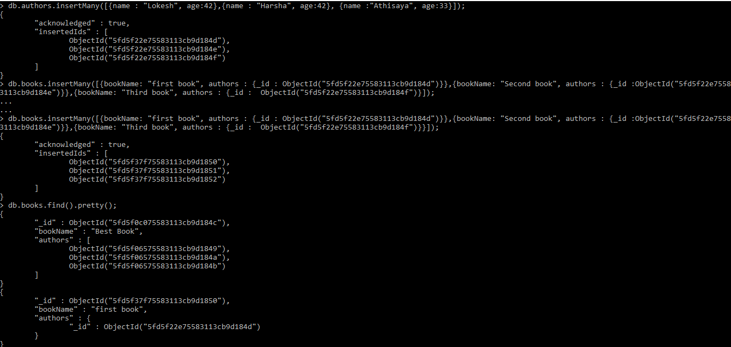
Many to Many Relationship (Authors & Books)

Slide 19
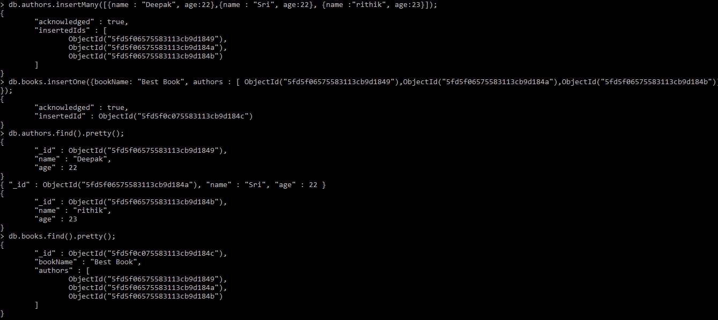
Many to One Relationship (Authors & Books)

Slide 20
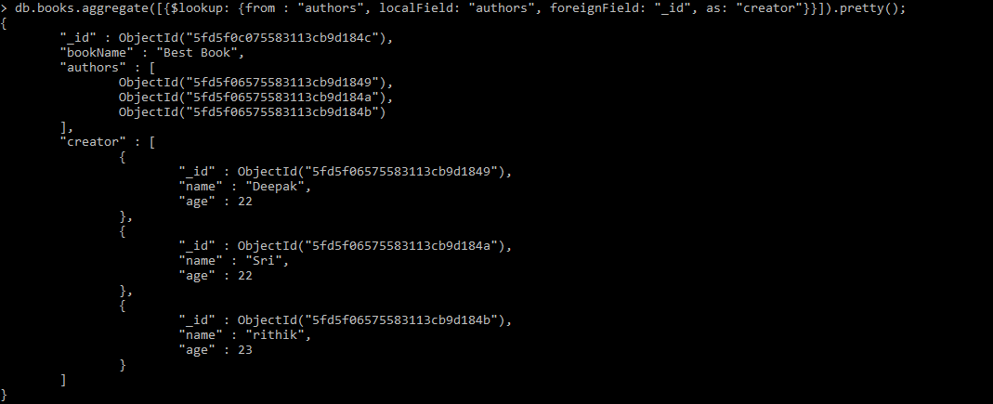
Aggregate

Slide 21
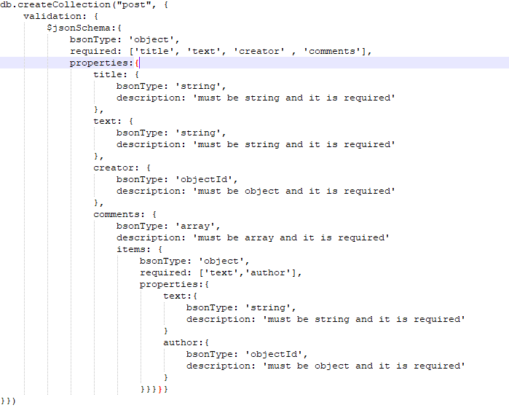
Validation

Slide 22
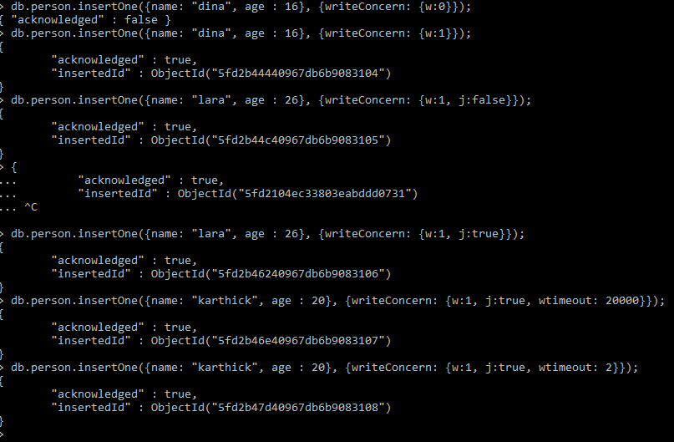
Write Concern

Slide 23

Next() → shows first 20 documents ForEach → shows all documents

